Slide 1
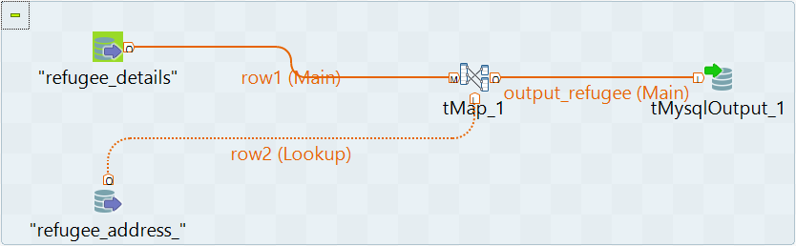
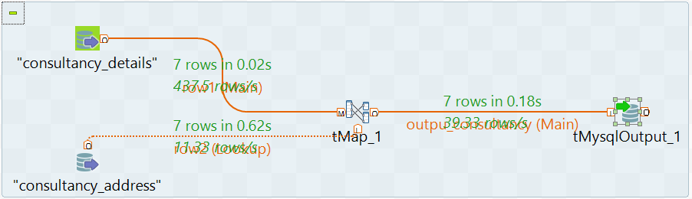
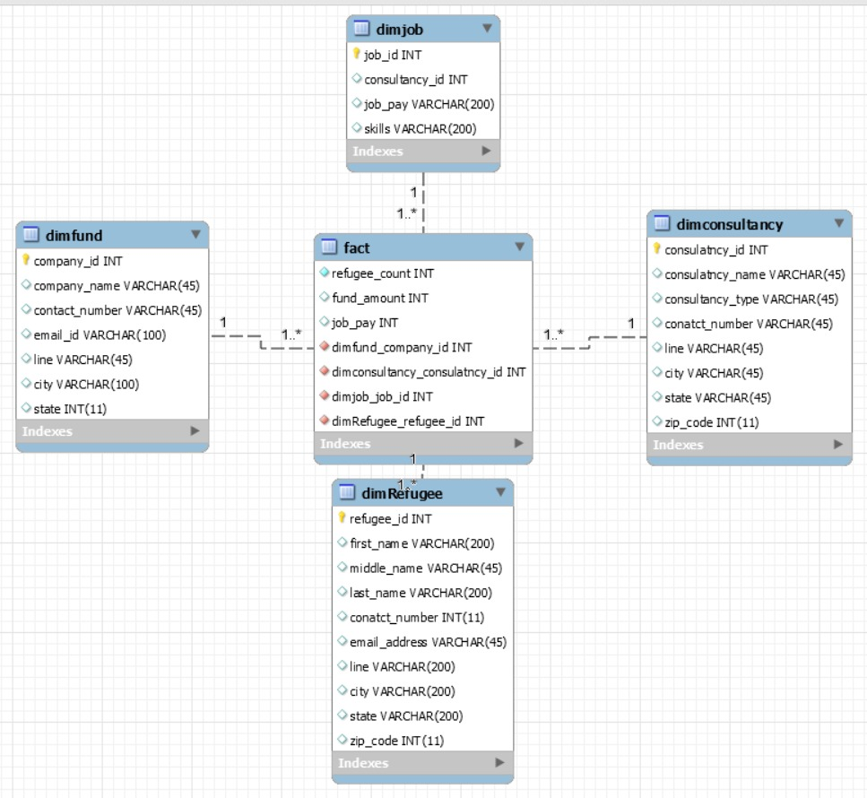
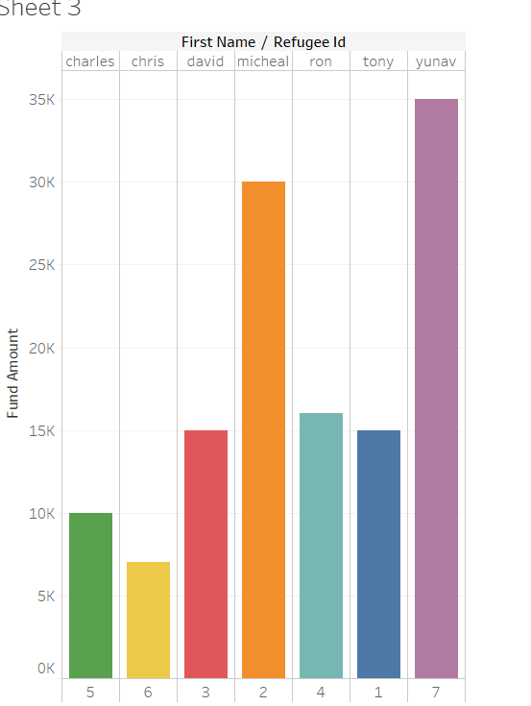
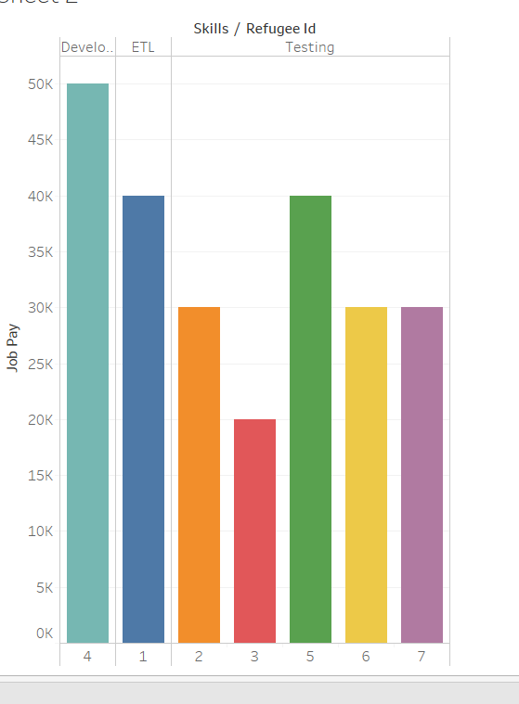
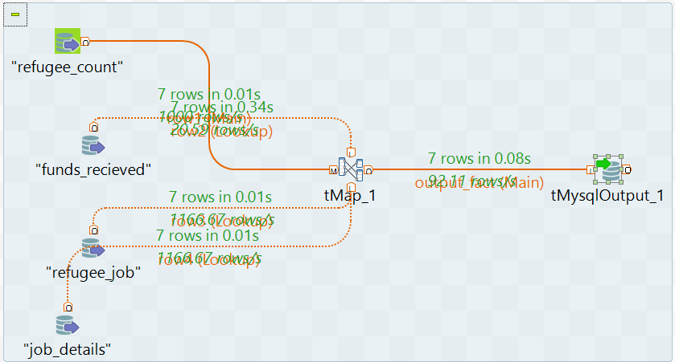
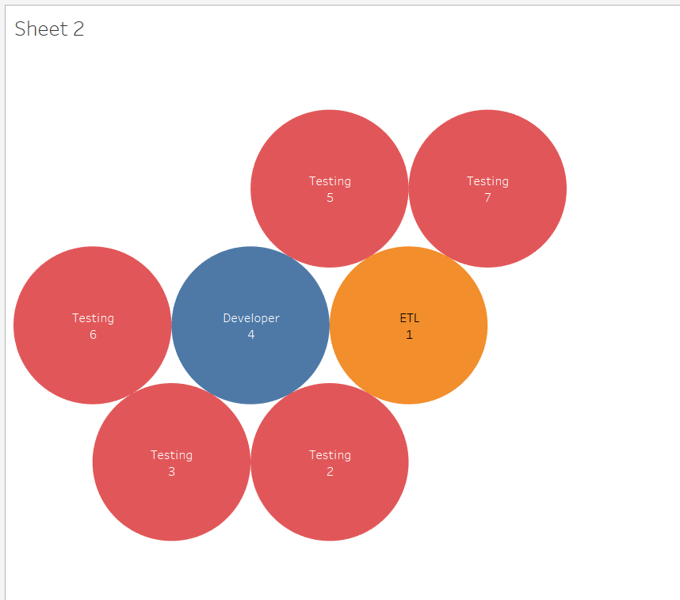
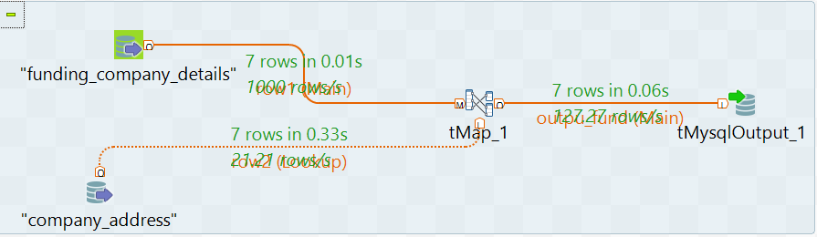
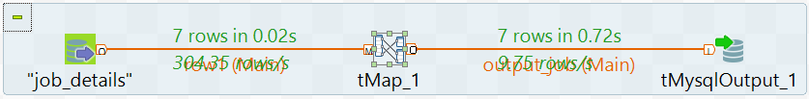
Finding the common tuples between Job Consultancy, Refugee and Social Service Department Databases.
Karthikeyan T K Ragunath, Pavan Soma, Umasankar Srinivas Varma Pusapati
University of North Carolina – Charlotte. Course ITCS 6163- Data Warehousing
Introduction
The below images show us different jobs designed in Talend ETL tool to perform ETL tasks. Each job extracts data from the given source tables from different databases, transform it to a required form and load it into destination table. Once the results are obtained, it is visualised in charts using Tableau Software.
Results
Relationship of records across databases has become an important tool for combining records that belong to the same entity across different data sources. When unique identifiers are not available or deterministic record linkage is not possible, probabilistic record linkage may be used to create additional matches based on probability scores that pair records belonging to the same individual. The success of record linkages is dependent on the quality of the individual data sources and identifiers as well as the accuracy of the record linkage process, which often involves manual review. The goal is therefore to reduce the number of mismatches and unlinked records and in turn to reduce the potential for systematic biases.
Data from Job Consultancy
Who received the maximum funding from the sponsors? (fig 8) It tells us Refugee named yuvan got highest funding.
2. On Which skill sets job agents are providing jobs more refugees? (Fig10) It tells us consultancies are providing more jobs on Testing.
3. Which refugees got the highest pay?(Fig9) It tells us which refugee got highest after getting a job through consultancy.
Based on the above problem statements we have performed analysis data warehouse and give output to tableau to visualize the data. Apart from this we can also gain many other insights from the data warehouse.
refugee_id job_id company_id
Data from Social Service Department
Data from Refugees
Fig.1. Data Flow
Data Warehouse Schema
Considering its query performance and efficiency in navigating through data, Star schema has been used to build the Data Warehousing. In our Data Warehouse, we have a one fact table and four dimension tables. Each of these four dimension tables (dimconsultancy, dimfund, dimjob, dimrefugee) are connected to the fact table using foreign keys.
Fig.3. dim_refugee
Objectives
The objective of this project is to describe data management and the record linkage between the Refugees, Job Consultancy, and Social Service Department (Funding) databases. To estimate how the funding is received and distributed equally to refugees of all categories and then maintaining that data simultaneously in the job consultancy database.
Fig.4. dimconsultancy
Database Design
There are three databases considered for this project. They are Job consultancy, Refugee, and Funding Database. The Job Consultancy database has following tables: consultancy_details, consultancy_address, job_details and refugee_job. Refugee_job table holds a linkage between job consultancy and Refugee databases. Refugee database has following tables: refugee_details and refugee_address. Funding database has following tables: funding_company_details, company_address and funds_recieved. Here funds_received act as relation between Refugee and Funding database.
Fig.8.
Fig.9.
Fig.5. dimfact
Fig.2. Data Warehouse Schema
Data Flow
Talend ETL
The primary key refugee_id is the common field in three databases to keep track of the relation among records among the tables. A Refugee has one to many relationship with the job consultancy table which indicates that a refugee can be put in one or more jobs. This makes sure that the refugee is guaranteed to be using his time and saving more money. Thus, it also helps in funding him less since the refugee keeps him paid with his work.
We used Talend for ETL purpose. Initially, data has been extracted from all three databases. Then the extracted data is transformed based on our requirements for our analysis. Once the data is transformed, it is loaded into the Target database on which we perform our queries to extract the necessary information.
Fig.6. dimfund
Fig.7. dimjob
Fig.10.

